Slide 1
Features and Basics of C++
Programming

Slide 2
Elements & Structure of C++ program
Common elements:
  Keywords
  Programmer-Defined Identifiers
  Operators
  Punctuation
  Syntax

Slide 3
Elements & Structure of C++ program
Keywords:
  Also known as reserved words
  Have a special meaning in C++
  Cannot be used for any other purpose
  Keywords in the Program 1-1: using, namespace, int, double, and return.

Slide 4
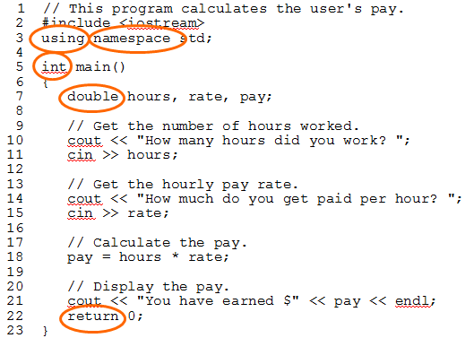

Elements & Structure of C++ program

Slide 5
Elements & Structure of C++ program
Identifiers:
  Names made up by the programmer
  Not part of the C++ language
  Used to represent various things: variables (memory locations), functions, etc.
  In Program 1-1: hours, rate, and pay.

Slide 6
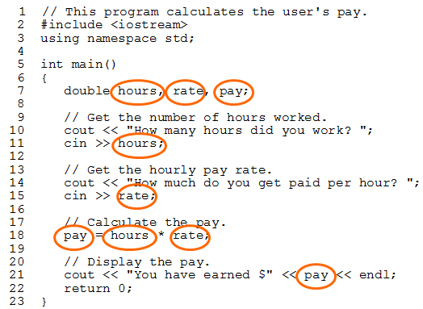
Elements & Structure of C++ program

Slide 7
Elements & Structure of C++ program
Operators:
  Used to perform operations on data
  Many types of operators:
    Arithmetic - ex: +,-,*,/
    Assignment – ex: =
  Some operators in Program1-1:
  << >> = *

Slide 8
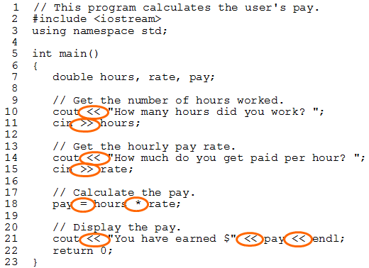
Elements & Structure of C++ program

Slide 9
Elements & Structure of C++ program
Variables:
  A variable is a named storage location in the computer’s memory for holding a piece of data.
  In Program 1-1 we used three variables:
    The hours variable was used to hold the hours worked
    The rate variable was used to hold the pay rate
    The pay variable was used to hold the gross pay

Slide 10
Elements & Structure of C++ program
Data Types:
  Primitive/Basic:
    Integer: short, int, long
    Real: float, double, long double
    Character: char
    Unsigned:
      Unsigned char
      Unsigned int
      Unsigned long
      Unsigned short

Slide 11
Elements & Structure of C++ program
  Derived/User-defined:
    Array → []
    Strings → char[]
    Structures → struct
    Unions → union
    Enumerations → enum
    Classes → class

Slide 12
Elements & Structure of C++ program
  Pointers & References:
    Pointers → *
    Reference → &
  Empty:
    void

Slide 13
Storage Classes
It defines following characteristics of variables:
  Storage Location → (RAM, CPU Registers)
  Default Value → (Garbage, Zeroed-out)
  Accessibility Scope → (local, global)
  Lifetime → (function-restricted, entire program)
Storage classes supported by C++:
  auto (default for local)
  Register (faster access, expensive location)
  Static (retains value)
  Extern (default for global)

Slide 14
The cout Object
Displays output on the computer screen
You use the stream insertion operator << to send output to cout:
  cout << "Programming is fun!";

Slide 15
The cout Object
Can be used to send more than one item to cout:
  cout << "Hello " << "there!";
  Or:
  cout << "Hello ";
  cout << "there!";

Slide 16
The cout Object
This produces one line of output:
cout << "Programming is ";
cout << "fun!";

Slide 17
The cin Object
Standard input object
Like cout, requires iostream file
Used to read input from keyboard
Information retrieved from cin with >>
Input is stored in one or more variables

Slide 18
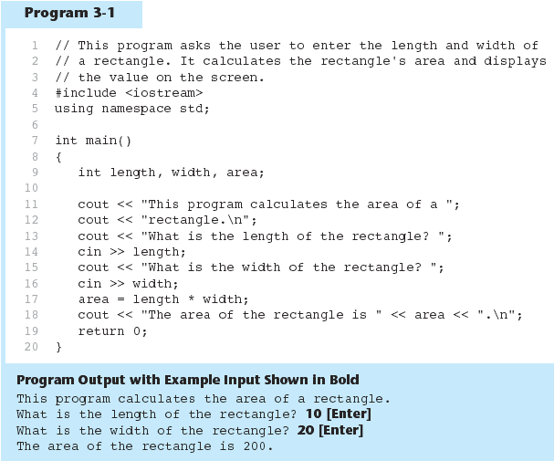
The cin Object example

Slide 19
The cin Object
cin converts data to the type that matches the variable:
  int height;
  cout << "How tall is the room? ";
  cin >> height;

Slide 20
The cin Object
Can be used to input more than one value:
  cin >> height >> width;
Multiple values from keyboard must be separated by spaces
Order is important: first value entered goes to first variable, etc.

Slide 21
Reading Strings with cin
Can be used to read in a string
Must first declare an array to hold characters in string:
  char myName[21];
nyName is name of array, 21 is the number of characters that can be stored (the size of the array), including the NULL character at the end
Can be used with cin to assign a value:
  cin >> myName;

Slide 22
Mathematical Expressions
Can create complex expressions using multiple mathematical operators
An expression can be a literal, a variable, or a mathematical combination of constants and variables
Can be used in assignment, cout, other statements:
  area = 2 * PI * radius;
  cout << "border is: " << 2*(l+w);

Slide 23
Order of Operations
In an expression with more than one operator, evaluate in this order:
  - (unary negation), in order, left to right
  * / %, in order, left to right
  + -, in order, left to right
In the expression 2 + 2 * 2 – 2
evaluate
first
evaluate
third
evaluate
second

Slide 24
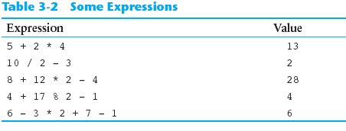
Order of Operations

Slide 25
Associativity of Operators
- (unary negation) associates right to left
*, /, %, +, - associate right to left
parentheses ( ) can be used to override the order of operations:
  2 + 2 * 2 – 2 = 4
  (2 + 2) * 2 – 2 = 6
  2 + 2 * (2 – 2) = 2
  (2 + 2) * (2 – 2) = 0

Slide 26
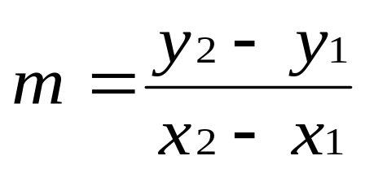
Algebraic Expressions
Multiplication requires an operator:
  Area=lw is written as Area = l * w;
There is no exponentiation operator:
  Area=s² is written as Area = pow(s, 2);
Parentheses may be needed to maintain order of operations:
  is written as
  m = (y2-y1)/(x2-x1);

Slide 27
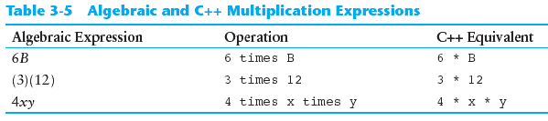
Algebraic Expressions

Slide 28
Hierarchy of Types
long double
double
float
unsigned long
long
unsigned int
int
Highest:
Lowest:
Ranked by largest number they can hold

Slide 29
Type Coercion
Type Coercion: automatic conversion of an operand to another data type
Promotion: convert to a higher type
Demotion: convert to a lower type

Slide 30
Coercion Rules
1) char, short, unsigned short automatically promoted to int
2) When operating on values of different data types, the lower one is promoted to the type of the higher one.
3) When using the = operator, the type of expression on right will be converted to type of variable on left.

Slide 31
Relational Operators
Used to compare numbers to determine relative order
Operators:
> | Greater than
< | Less than
>= | Greater than or equal to
<= | Less than or equal to
== | Equal to
!= | Not equal to

Slide 32
Relational Expressions
Boolean expressions – true or false
Examples:
  12 > 5 is true
  7 <= 5 is false
  if x is 10, then
  x == 10 is true,
  x != 8 is true, and
  x == 8 is false

Slide 33
Relational Expressions
Can be assigned to a variable:
  result = x <= y;
Assigns 0 for false, 1 for true
Do not confuse = and ==

Slide 34
Logical Operators
Used to create relational expressions from other relational expressions
Operators, meaning, and explanation:
&& | AND | New relational expression is true if both expressions are true
|| | OR | New relational expression is true if either expression is true
! | NOT | Reverses the value of an expression – true expression becomes false, and false becomes true

Slide 35
Logical Operators - examples
int x = 12, y = 5, z = -4;
(x > y) && (y > z) | true
(x > y) && (z > y) | false
(x <= z) || (y == z) | false
(x <= z) || (y != z) | true
!(x >= z) | false

Slide 36
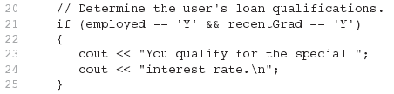
The && Operator

Slide 37

The || Operator

Slide 38

The ! Operator

Slide 39
Logical Operators - notes
! has highest precedence, followed by &&, then ||
If the value an expression can be determined by evaluating just the sub-expression on left side of a logical operator, then the sub-expression on the right side will not be evaluated (short circuit evaluation)

Slide 40
Checking Numeric Ranges with Logical Operators
Used to test to see if a value falls inside a range:
  if (grade >= 0 && grade <= 100)
  cout << "Valid grade";
Can also test to see if value falls outside of range:
  if (grade <= 0 || grade >= 100)
  cout << "Invalid grade";
Cannot use mathematical notation:
  if (0 <= grade <= 100) //doesn’t work!

Slide 41
The if Statement
Allows statements to be conditionally executed or skipped over
Models the way we mentally evaluate situations:
  "If it is raining, take an umbrella."
  "If it is cold outside, wear a coat.“
General Format:
  if (expression)
  statement;

Slide 42
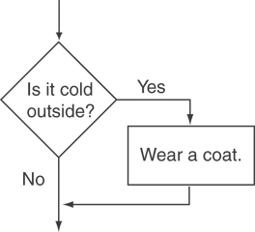
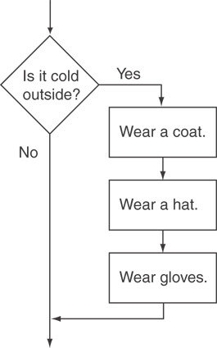
Flowchart for Evaluating a Decision

Slide 43
The if Statement
Do not place ; after (expression)
Place statement; on a separate line after (expression), indented:
  if (score > 90)
  grade = 'A';
Be careful testing floats and doubles for equality
0 is false; any other value is true

Slide 44
The if/else Statement
General Format:
  if (expression)
  statement1; // or block
  else
  statement2; // or block

Slide 45
The if/else Statement
To evaluate:
  if (expression)
  statement1;
  else
  statement2;
If the expression is true, then statement1 is executed and statement2 is skipped.
If the expression is false, then statement1 is skipped and statement2 is executed.

Slide 46
Nested if Statements
An if statement that is nested inside another if statement
Nested if statements can be used to test more than one condition

Slide 47
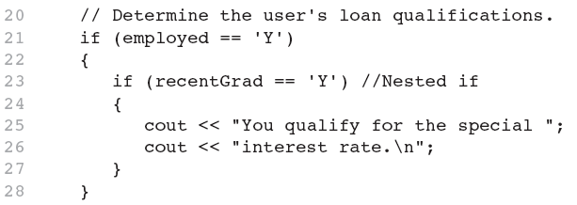
Nested if Statements

Slide 48
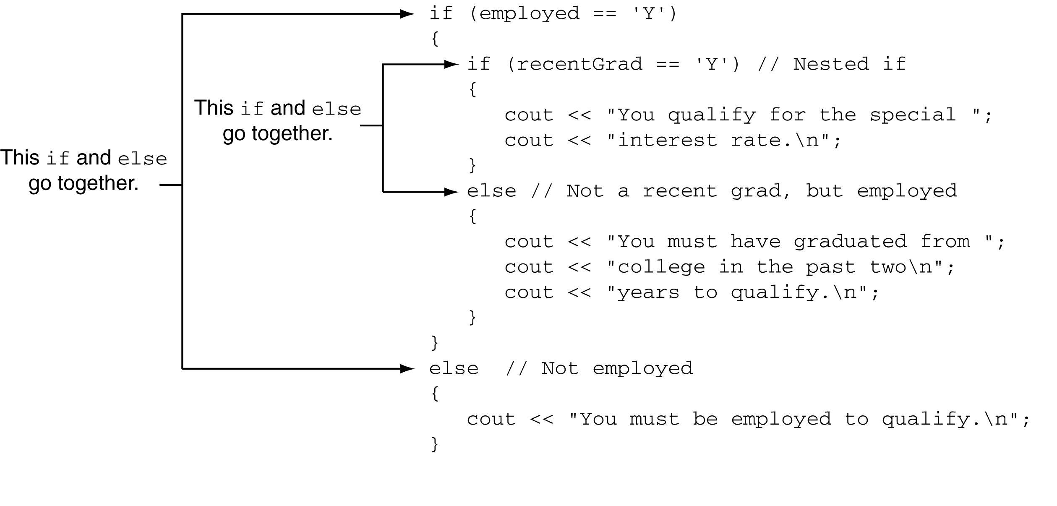
Use Proper Indentation!

Slide 49
The if/else if Statement
Tests a series of conditions until one is found to be true
Often simpler than using nested if/else statements
Can be used to model thought processes such as:
"If it is raining, take an umbrella,
else, if it is windy, take a hat,
else, take sunglasses”

Slide 50
if/else if format
  if (expression)
  statement1; // or block
  else if (expression)
  statement2; // or block
  .
  . // other else ifs .
  else if (expression)
  statementn; // or block

Slide 51
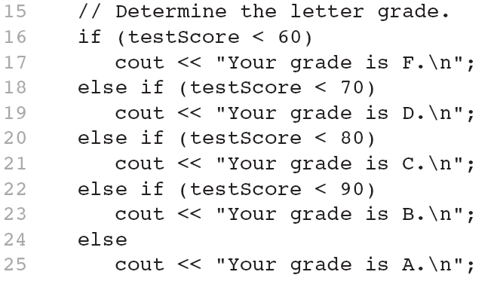
if/else if example

Slide 52
Using a Trailing else to Catch Errors
The trailing else clause is optional, but is best used to catch errors
From Program 4-14:
This trailing else catches invalid test scores
15 // Determine the letter grade.
16 if (testScore < 60)
17 cout << "Your grade is F.\n";
18 else if (testScore < 70)
19 cout << "Your grade is D.\n";
20 else if (testScore < 80)
21 cout << "Your grade is C.\n";
22 else if (testScore < 90)
23 cout << "Your grade is B.\n";
24 else if (testScore <= 100)
25 cout << "Your grade is A.\n";
26 else
27 cout << "We do not give scores higher than 100.\n";

